Slide 1
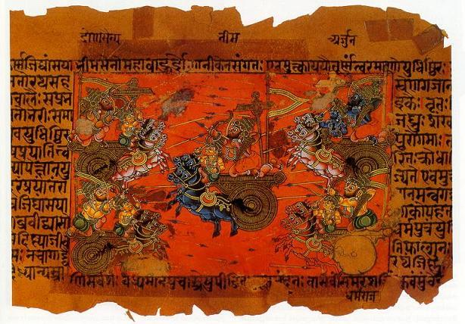
Ancient Indian Literature
Presented by
Mita Sen
February 2-3, 2011

Slide 2
The Indian Civilization: Some History
One of the most ancient civilizations of the world, known as the Sindhu civilization or the Indus Valley Civilization or the Aryan Civilization
  Sometimes also referred to as the Vedic civilization, kindled by the Aryans on the banks of the river Sindhu (Indus) in the Northern India
  Later, they helped spread it across some other parts of the country
  The scholars differ on the period of its development
Even the origin of the Aryan race has been debatable
  Some historians believe that the Aryans migrated from the North Central Asia and settled in India. Some other historians contend that the Aryans have been the natives of India.
Common opinion: the Aryan civilization is 4000 to 8000 years old

Slide 3
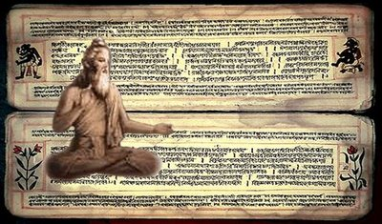
The Indian Scriptures, Classified as:
The Shruti literature: The Sanskrit root “shrut” means “to hear.” In ancient times, while doing their tapasya and sadhana (meditation), the great sages “heard” the divine truths, which were “revealed” to them.

Slide 4
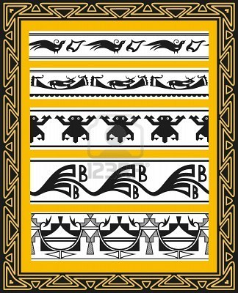
2. The Smriti literature: This form is concerned with “the remembered,” literature based on the knowledge acquired through the experience or tradition and passed on through generations.

Slide 5
The Smriti literature is based on the Shruti
  It includes the guidelines for ethics, moral obligations, social codes, customs etc.
The Vedas and the Upanishads are considered as the Shruti literature
The great epics Mahabharata and Ramayana belong to the Smriti literature
While the Shruti literature is authentic and sacred, the Smriti literature may get modified under the influence of time and place

Slide 6
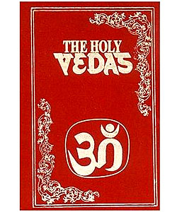
The Vedas are considered to be the most sacred heritage of mankind. They reflect the growth and development of human thoughts, over a span of scores of centuries.
The Vedas are regarded as divine in origin. They are not produced by a couple of individuals nor composed by some poets or authors.
The Vedas constitute the sublime knowledge revealed by the Supreme Divinity, to our great ancestors while they meditated.
Whatever was “heard” or “revealed” to the great sages was presented in the Vedas and the Upanishads.

Slide 7
The Vedas encompass the human life, but are not limited to a particular religion or a race or a country
They are the holy scriptures of Hinduism, but they equally belong to the total human race. They symbolize "the earliest documents of the human mind.”
(Dr. Radhakrishnan, a twentieth-century scholar)

Slide 8
The Vedas present the. sublime form of knowledge
  This knowledge is impersonal
  It is divine. It is absolute and indisputable
  It is eternal and remains unaffected at all times, at all places, under all circumstances
Hence the Vedas are accepted as the Swatah Pramana or self-evident
  That means the “truths” do not need any proof, support, or elaboration

Slide 9
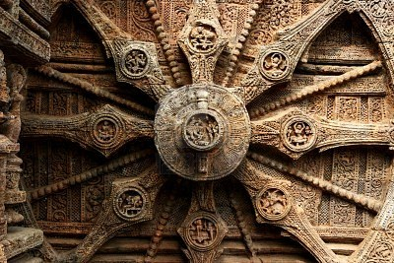
Some Unique Attributes:
The Vedas are eternal, timeless, with no beginning or end
They were not composed at a certain time
  Although in verbal form, acquired during certain period in history, the Vedas are eternal truths beyond the confines of time

Slide 10
What do the Vedas Contain?
Mantras, or hymns addressed to the deities
  These mantras are for ceremonial purposes or for the rites and rituals
Some deal with the social life, including references to the sciences and mathematics
  Specifically, discussions on chemistry, astronomy, botany, zoology, physiology, medical therapeutics and bio-sciences
They reflect all the aspects of existence, shedding light on the Srishti, the Brahman, the atman, the life and all the related issues of spiritualism
The Vedas present a record of the philosophical progress of man, but do not propagate any specific ideology or doctrine

Slide 11
The meaning of the word "Veda”:
The word “Veda” is interpreted in more than one ways by different scholars
“Veda” originates from the Sanskrit root Vid—”to know” (literally, knowledge)
  When the man was in a primitive stage, enveloped in darkness, the philosophy of the Veda was the unprecedented glow of knowledge
  The knowledge which transformed a prakrit (natural) man to a Sanskrit (knowledgeable) man is the Veda
“Veda” also means “to be,” (astitva—the existence—and that which creates awareness in a man about his own existence)

Slide 12
“Veda” also means “to think” (suggesting that thinking awakens discretion in a man’s mind, making a man wise and judicious)
  The knowledge helps to distinguish between Sat and Asat.
“Veda’”also refers to “accomplishment” (the knowledge that helps a man in realizing his supreme goal)
“Veda” also means “to think” (suggesting that thinking awakens discretion in a man’s mind, making a man wise and judicious)
  The knowledge helps to distinguish between Sat and Asat
Finally, “Veda” also refers to “accomplishment” (the knowledge that helps a man in realizing his supreme goal)

Slide 13
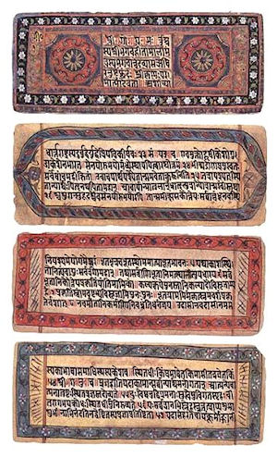
Summary:
The Vedas are the most celebrated possessions of the mankind and Rig Veda is the oldest literary work in the history of the world.
They are the first significant utterances on the lips of man.
The ancient Indian literature is the glorious gift of the Indian civilization to the world.
ALSO:
  Indians believe that Ancient Indian literature is the crowning glory of the Indian civilization. No other part of the world has produced such voluminous literature of knowledge and wisdom.

Slide 14
From the Vedas to the Upanishads:
In the beginning, the Vedas spread polytheism
This illusion gradually disappeared with the approach of the Upanishadic period
  The Vedic philosophical thoughts reach the peak in the Upanishads
The Vedic Rishis were in search of the Ultimate Truth, on their quest for the Divine
  According to scholars, “The Upanishadic hymns are the epic hymns of self-knowledge, world-knowledge and God-knowledge,” the ULTIMATE TRUTH

Slide 15
The Rishis were inquisitive and they posed diverse questions:
  What is the Ultimate Truth?
  What is the Srishti? Who is the creator?
  How and why is the Samsara (Jagat) created?
  What is the Brahman?
  What is the jiva or the jivatma?
  Is there any relationship between the Brahman and the jivatma?
  What is life? What is death? What is moksha?
Truly speaking, the Upanishads reflect the sublime knowledge and wisdom of man in its most exalted form

Slide 16
The Upanishads
Upanishad means the inner or mystic teaching. The term “Upanishad” is derived from upa (near), ni (down) and s(h)ad (to sit), i.e., sitting down near.
  Groups of pupils sat around a teacher (the wise one) to learn from him the secret doctrine
  In the quiet forest hermitages, the “thinkers” pondered on the problems of deepest concerns and communicated their knowledge to fit pupils near them (like Aristotle, Plato, and Socrates)
“Upanishad” also means the knowledge of Brahma, by which ignorance is loosened or destroyed

Slide 17
The Upanishads more clearly set forth the prime Vedic doctrines like Self-realization, yoga and meditation, karma and reincarnation
The Purpose: To let it be known that Nirvana (liberation), the final goal of spiritual development becomes less desirable, as the seeker loses his own identity in his merging with the Absolute
The Upanishads give us both spiritual vision and philosophical argument.
  The core of truth is essentially incommunicable except by a way of life
  It is by a strictly personal effort that one can reach the truth

Slide 18
Some of the richest material in the Upanishads delineate the glory of the Absolute/God, the process of creation, prescribing different methods of upaasanaa, or meditation
The Upanishads convey four different styles (like the Greek philosophical quests):
Dialogue with questions and answers
Narration and episodes
Similes, metaphors and illustrations
Symbolism

Slide 19
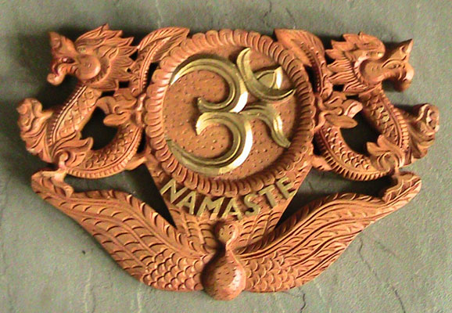
Symbolisms employed by the Upanishads are essentially of 3 types: Nature symbolism, sacrifices and sacrificial items used as symbols, and mystic sound syllables such as Aum being used as symbols

Slide 20
The central theme of the Upanishads is Monotheism, the concept of an all pervasive supreme being—the Brahma
  He is not nirguNa (attribute less), but is guNaparipuurNa—full of all possible auspicious qualities
The Supreme Principle is described as the Creator, Sustainer, Regulator, Destroyer, Enlightener and Liberator of all. It is also the one and only Independent Principle upon which all other entities are dependent
Being Infinite in all respects, it cannot be comprehended by anyone completely. It has no drawbacks or blemishes of any kind. It directs all and is not directed or constrained by anyone.

Slide 21
A Central Concept
Both the good and the pleasant approach a man. The wise man, pondering over them, discriminates. The wise chooses the good in preference to the pleasant. The simple-minded, for the sake of worldly well-being, prefers the pleasant.
Dharma: The Right Conduct
Karma: The Right Act

Slide 22
A Central Quotation from
The Upanishads
Om Asato maa sad-gamaya
Tamaso maa jyotir-gamaya
Mrtyor-maa- amrutam gamaya
Om Shaantih Shaantih Shaantihi
Translation: O Lord Lead me from the unreal to the real. Lead me from the darkness to light. Lead me from death to immortality. May there be peace, peace, and perfect peace

Slide 23
Indian Epics Compared to Other Western Epics
It is believed that Ancient Indian Literature predates many of the Western Literature
It has a huge canon of literature beginning with the Vedas, dating 16th to 11th Century BCE
The Upanishads date between 9th to 7th Century BCE
The Mahabharata, written approximately around 4th Century BCE
Ramayana is known to be written around 4th Century BCE

Slide 24
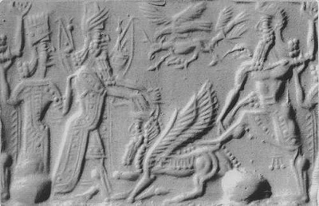
Epic of Gilgamesh
(Anonymous)
An epic poem from Ancient Mesopotamia; among the earliest known works of literary fiction
It is a series of Sumerian legends and poems about the mythological King Gilgamesh, who might have been a real ruler during the 27th century BC
The complete version exists today on twelve clay tablets
The story revolves around the relationship between a distracted and disheartened King Gilgamesh and a friend, Enkidu, who is half-wild and who undertakes dangerous quests with Gilgamesh
Much of the epic focuses on Gilgamesh’s thoughts of loss following Enkidu’s death, and a large portion of the book shows Gilgamesh’s search for immortality
The epic is widely read in translation, and the hero, Gilgamesh, has become an icon of popular culture.

Slide 25
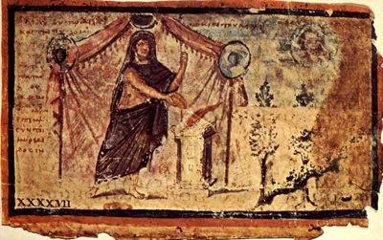
The Iliad by Homer
This, together with the Odyssey, is one of two ancient Greek epic poems attributed to Homer.
The poem is commonly dated to the late 9th or to the 8th Century BC and many scholars believe it is the oldest extant work of literature in the ancient Greek language, making it the first work of European literature.
The poem concerns events during the tenth and final year in the siege of the city of Ilion or Troy, by the Greeks.

Slide 26
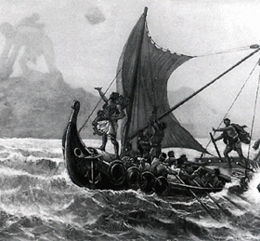
The Odyssey by Homer
This is one of two major ancient Greek epic poems attributed to Homer.
The poem was probably written near the end of the 8th Century BC, somewhere along the Greek-controlled western Turkey seaside Ionia.
The poem is, in part, a sequel to Homer’s Iliad and mainly centers on the Greek hero Odysseus and his long journey home to Ithaca following the fall of Troy.
It takes Odysseus ten years to reach his kingdom of Ithica after the ten-year Trojan War. During this absence, his son Telemachus and wife Penelope must deal with a group of unruly suitors, called Proci, to compete for Penelope’s hand in marriage, since most have assumed that Odysseus has died.

Slide 27
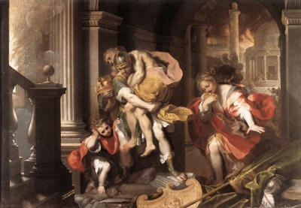
Aeneid by Virgil
The Aeneid is a Latin epic poem written by Virgil in the 1st Century BC (between 29 and 19 BC) that tells the legendary story of Aeneas, a Trojan who traveled to Italy, where he became the ancestor of the Romans.
The first six of the poem’s twelve books tell the story of Aeneas’ wanderings from Troy to Italy, and the poem’s second half treats the Trojans’ ultimately victorious war upon the Latins, under whose name Aeneas and his Trojan followers are destined to be subsumed.

Slide 28
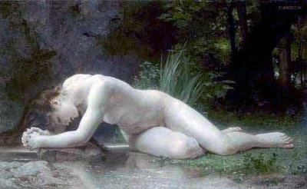
Metamorphoses by Ovid
This is a narrative poem in fifteen books that describes the creation and history of the world. Completed in 8 AD, it has remained one of the most popular works of mythology, being the classical work best known to medieval writers and thus having a great deal of influence on medieval poetry.

Slide 29
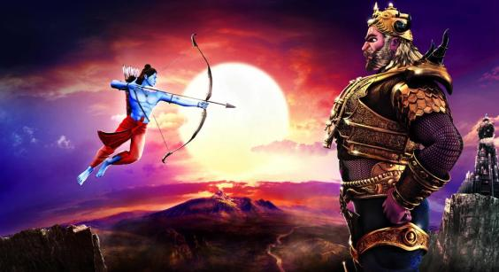
Comparing the immensity
(the number of lines)
of the Indian Epics to Other Epics:
The Iliad 15,000 The Odyssey 12,000 The Aeneid 10,000
The Mahabharat 215,000 The Ramayan 48,000

Slide 30
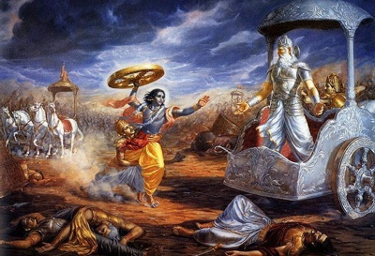
The Mahabharata
With more than 100,000 verses, long prose passages, and about 1.8 million words in total, the Mahābhārata is one of the longest epic poems in the world
It is of immense importance to the culture of the Indian subcontinent and is a major text of Hinduism
Its discussion of human goals artha (purpose), kama (pleasure), dharma (duty) and moksha (liberation) attempt to explain the relationship of the individual to society and the world and the workings of karma

Slide 31
The date of the Mahabharat (the mythical story!) ranges between 1000 BCE to 300 BCE
Astronomical and literary evidences or clues from the different ancient texts have been deciphered to provide a conclusive date for actual the Mahabharat War
The fifth century mathematician, Aryabhatta, calculated the date of the Mahabharat War to be approximately 3100 BCE from the planetary positions recorded in the Mahabharat

Slide 32
The word “Maha” in Sanskrit is an adjective that means something that is great or extraordinary, and “Bharata” is India, but this Epic is about much more than just India
  It transcends culture and religion and at the very core of the ancient storyline lies a simple theme that all of mankind can relate to
  It is a story of good versus evil, of families in turmoil, of jealousy and betrayal and at the heart of it all, a fight for the truth

Slide 33
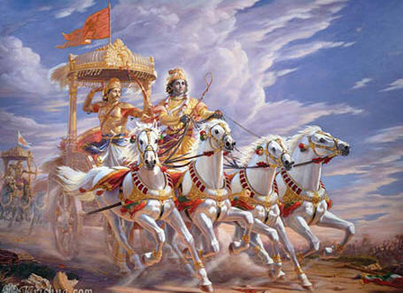
The Bhagavad Gita

Slide 34
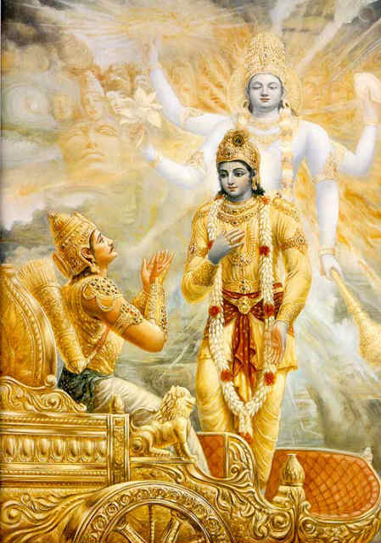
One Central Idea from The Gita:
Whenever virtue declines and unrighteousness rises, I manifest Myself as an embodied being.
To protect the Saints and Sages, to destroy the evil-doers and to establish Dharma (righteousness), I am born from
age to age.
(Bhagavad Gita 4.7 and 4.8)

Slide 35
The Significance of the Ancient Literature in Indian Life:
The Vedic mantras are still chanted in prayers, religious ceremonies and auspicious occasions of twenty-first century India. They are perennial!
The Mahabharata and Ramayana still hold enormous influence on our reading habits, and though the sages—Veda Vyas and Valmiki—are credited with their compositions, in reality these mammoth works were evolved by a series of writers and poets over the course of centuries, names lost in the realms of antiquity

Slide 36
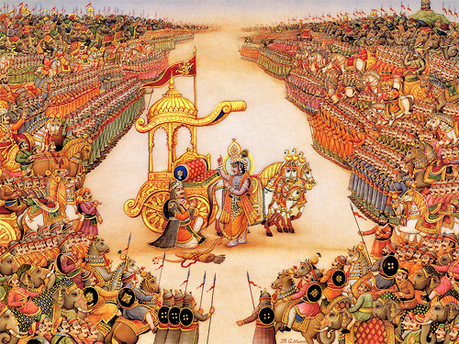
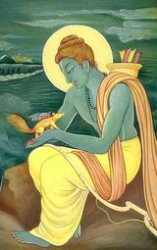
It is expected that all children in India be exposed to these great works in their early years to learn moral conduct and ethical behavior!

Slide 37
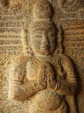
Peace Chant
May He (the Supreme Being)
protect us both, teacher and
taught.
May He be pleased with us.
May we acquire strength.
May our study bring us
illumination.
May there be no enmity among us.
OM! Peace! Peace! Peace!

